Slide 1



Welcome
Good morning,students!

Slide 2
A.B.M.Ziauddin Ahammad
Assistant Teacher
Harun Govt. Primary School
Adarsha Sadar, Comilla

Slide 3

Class: Five
Subject: English
Lesson:A Firefighter
Date:13/05/2013

Slide 4

At the end of the lesson students will be able to:-
1.Learn about a new profession;
2.Learn some new words;
3.Make some new sentences.

Slide 6
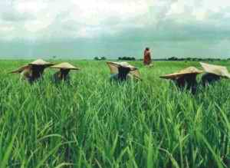
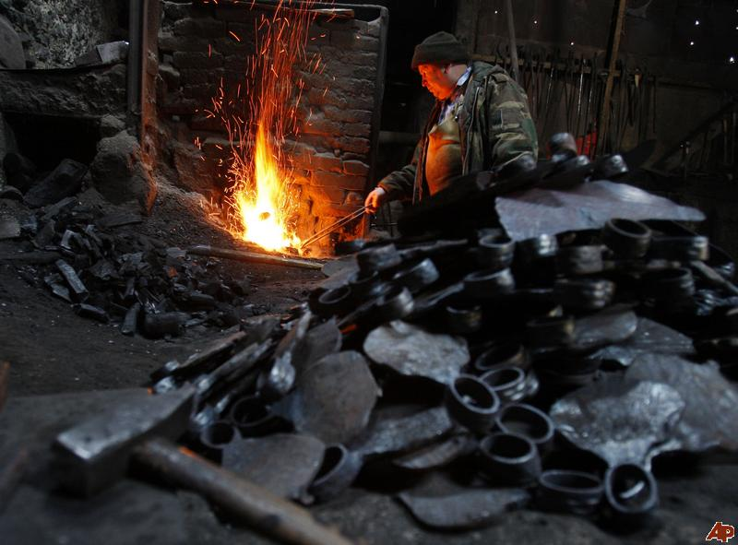
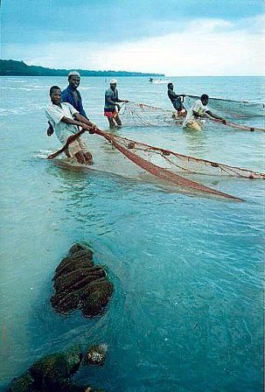
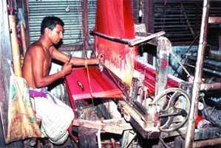
FARMER
BLACKSMITH
FISHERMAN
TANTI

Slide 7
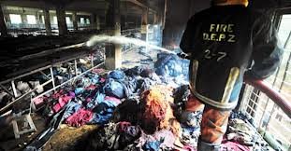

A Firefighter

Slide 8
Teacher’s loud reading

Slide 9
Students loud reading
(one after another)

Slide 10
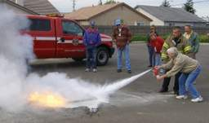
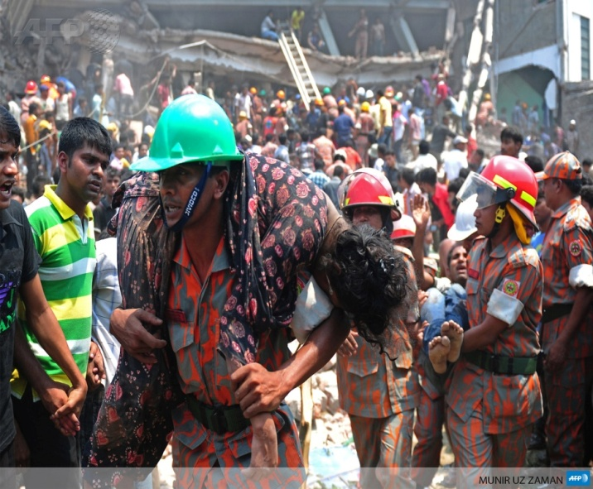
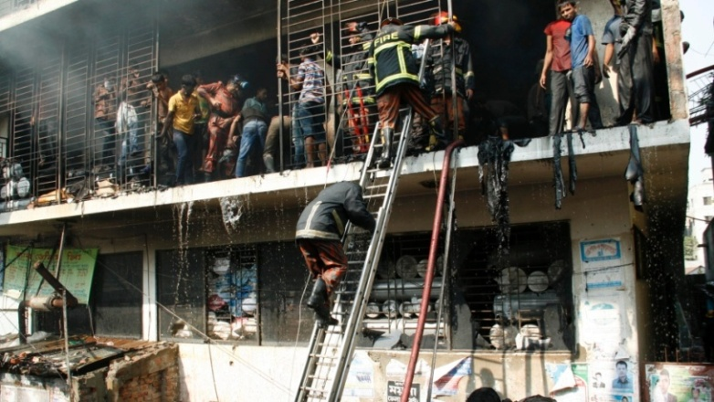
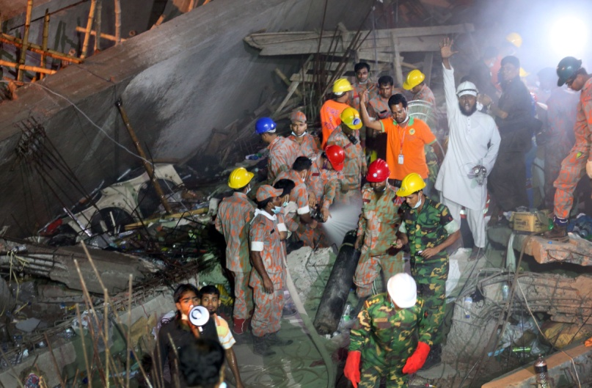
PUTTING OUT FIRE
RESCUE TEAM
RESCUR TEAM
RESCUE TEAM

Slide 11


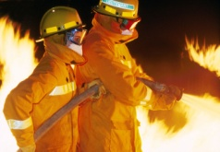

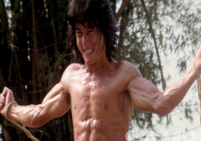

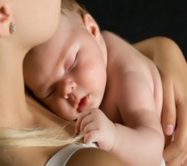
Students silent reading
Try to find out the new words(individually)
Panicked
Put out
Brave
Careful
Safe

Slide 12

Group works
Lily
Rose
Marigold
Make sentences with the new words

Slide 13
Task
Think of a person who works in your area to help you live well.Write a composition on this person.

Slide 14
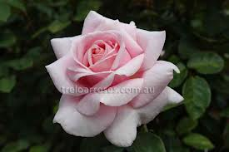
See you again .Bye!

